Slide 1
MECOP Selection Interviews
Some Helpful Information

Slide 2
Important! Dress for Success
For men
Dress shirt with collar, slacks, dress shoes, tie. dress coat optional.
For women
Pantsuit, skirted suit, or professional-style dress; low-heeled pumps

Slide 3
Get-Acquainted - Logistics
… in your assigned interview room
BE THERE !!
This is the time to create your first impression. Try to meet all the interviewers
Sign in and pick up your name-tag.
Interval between Get-acquainted session and actual interview is free time.

Slide 4
Get Acquainted - Don't be Shy
Smile
Introduce yourself in the get-acquainted sessions
Wear your name-tag
Ask some questions about the interviewers' companies

Slide 5
The Interview - Logistics
Be there 15 minutes before your scheduled interview time
A faculty member will introduce you to the interview panel ( do not!! enter the interview room uninvited)
Actual interview duration is about 10-12 minutes

Slide 6
The Interviewers
3 to 5 interviewers
Interviewers are experienced company reps.
Many have been through this on both sides of the table
They will help you feel at ease. They want you to do well!
All have looked at your applications in advance

Slide 7
The Interview: Ratings
Interviewers will rate you on -
Commitment/Motivation
Problem-Solving Skills
Communication Skills
Creativity
Ability to work with others
GPA

Slide 8
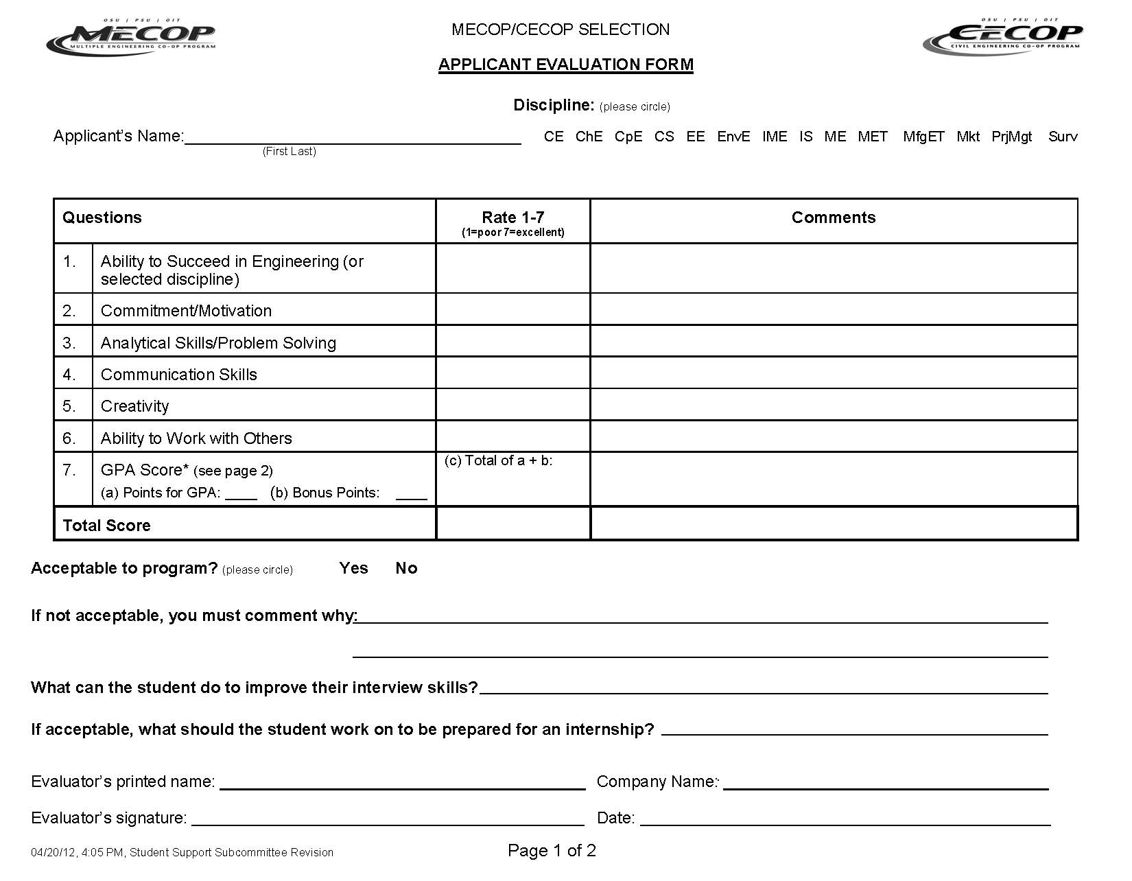

Slide 9
The Interview: Behavioral Questions
Behavioral questions typically start with, “Tell us about a time/project/etc. when you did . . .”
Remember these three steps:
Explain the SITUATION
Outline ACTIONS you took to resolve the situation
What were the RESULTS?
Situation | Actions | Results

Slide 10
The Interview: Probable Topics/Questions
Tell a bit about yourself (be brief)
How you became interested in IS/MKT/MGT/BUS
Projects you've worked on
Problems you've solved and how (any problem)
Teams you've worked with
Dynamics, leadership, etc.
Disagreements you've handled and how
What kind of job interests you the most? Why?
Work / extra-curricular activities?
Others

Slide 11
Tips
Relax (a bit), smile (but no ‘you guys’)
Provide a few details (about projects, etc.), but don’t ramble - be concise
If a question takes you by surprise, it's OK to take a few seconds to think about your response
Interviewers will help you out
If you work while taking classes, be sure to tell the interviewers (they will ask anyway)
If you have a question, don’t hesitate to ask
Let the interviewers know that you are -
-willing to locate anywhere (in Oregon, WA, ID)
-committed to 2 internships
Beware of the killer question
Remember to thank the panel

Slide 12
Questions ?
Good luck!

